Slide 1



We will begin shortly……….. please wait…..

Slide 2

“Python for Automation”
PDSC Workshop Day-2
Deepak Thapa
Third Year,
Electrical Engineering, Pulchowk Campus
9861796278
a.thapa.deepak@gmail.com

Slide 3
First Things First

Slide 4
Objectives:
Learn to use modules and methods
Learning conversion of images to PDF
Learn to send emails without browser

Slide 5
Installing modules:
Run cmd and type the following commands:
pip help
pip install module_name

Slide 6
Importing Modules and Methods:
Importing modules can be done by the following syntax:
import module_name
from module_name import function_or_class_or_variable
import module_name as mn

Slide 7
Converting Images to PDF:
We need to install img2pdf module for this purpose:
Goto command prompt and type
pip install img2pdf

Slide 8
Using Img2PDF:
Syntax for img2pdf is as below but we need to add some more codes to see the action:
import img2pdf
img2pdf.convert(“path of the file”)

Slide 9
Sending Emails with Python:
Before we write code disable two step verification and follow the link below:
click me

Slide 10
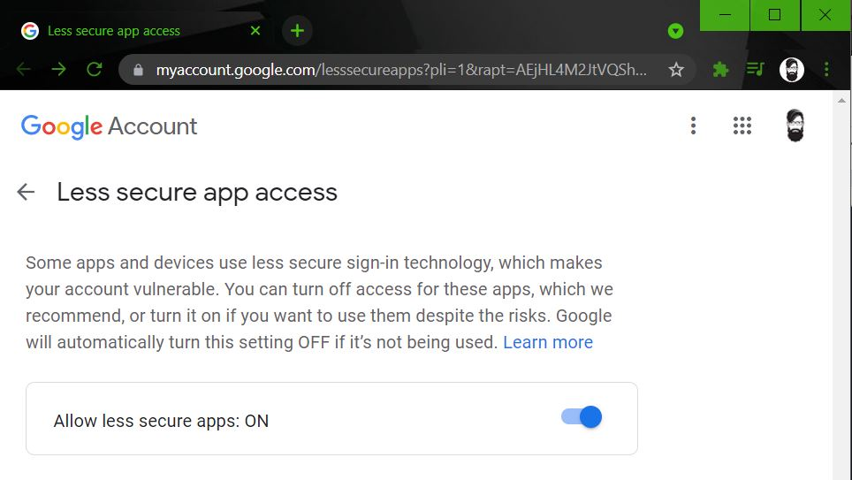

Slide 11
Getting into writing Script:
First thing first let’s introduce to smtplib module:
import smtplib
with smtplib.SMTP(‘smtp.gmail.com’, 587) as smtp:
smtp.ehlo()
smtp.starttls()
smtp.ehlo()
smtp.login(email_add,password)
msg = f”Subject: {“hello”}\n\n{“how are you?”} ”
smtp.sendmail(email_add, reciver_mail, msg)

Slide 12
ADDING ATTACHMENT AND SENDING MAIL:
from email.message import EmailMessage
msg = EmailMessage()
msg['Subject'] = 'hello'
msg['From'] = ‘falano@gmail.com’
msg['To'] = 'dhiskano@gmail.com'
msg.set_content(‘how you doin?’)
with open(image_path, ‘rb’) as f:
File_data = f.read()

Slide 13
//contd. from prev…...
msg.add_attachment(file_data, maintype=’image’,
subtype=’jpeg’,file_name)
with smtplib.SMTP_SSL(‘smtp.gmail.com’, 465) as smtp:
smtp.login(sender_email,password )
smtp.send_message(msg)

Slide 14
References and Links:
https://www.w3schools.com/
https://youtu.be/CqvZ3vGoGs0?list=PL5h5ls4NVm65pQiETOPL5Rt-QwEVFzbBW
https://youtu.be/VqCdRT1tREg?list=PL5h5ls4NVm65pQiETOPL5Rt-QwEVFzbBW
https://youtu.be/JRCJ6RtE3xU?list=PL5h5ls4NVm65pQiETOPL5Rt-QwEVFzbBW

Slide 15

Any
Questions?

Slide 16
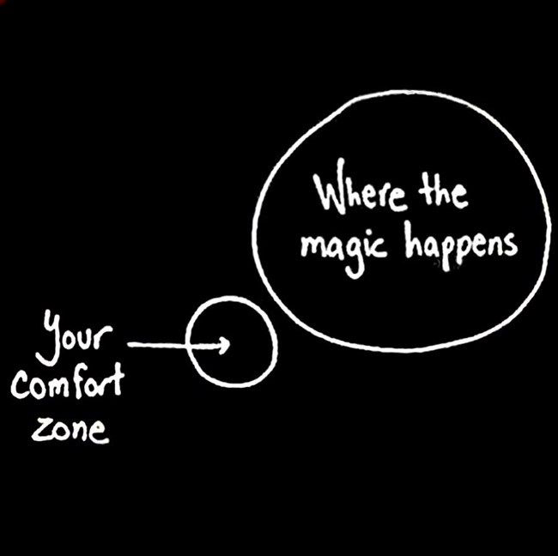
Thank You and All The Best.

